Slide 1
Taha Abdelwahab Amin Elsayed, Beabkal Yigezu Eshete Dilshod Turopovich Inomov
A project on Spark-Streaming, Flume, HBase, Hive, Impala, and Kafka.

Slide 2

Weather system
Display temperature and humidity for 20 large cities of the US every 3 minutes from OpenWeatherMap server.

Slide 3
Agenda for today
Project Description
Tools used to build our weather system.
Challenges faced during this short time.
Demo!
Questions & Thank you !

Slide 4
Project Description
Part 1 Goals:
Integrate OpenWeatherApp with our Weather System component which fetches weather data using OpenWeatherApp API and stores into file in spooldir for Flume
Flume reads stored weather data file and publishes that data into kafka topic.
Part 2 Goals:
Spark streaming project reads data from kafka then stores it into Hbase
Part 3 Goals:
Using Hive and Impala display updated weather data in human readable form.
Part 4 Goals:
Record video to demo how weather system works

Slide 5





Tools
Used technologies
Java Development Kit (JDK) 8 or higher
Apache Maven (for building Java projects)
Apache Kafka
Apache Flume
Apache HBase
Apache Spark (with Spark Streaming)
Apache Hive
Impala
Git (for version control)
Integrated Development Environment Eclipse

Slide 6
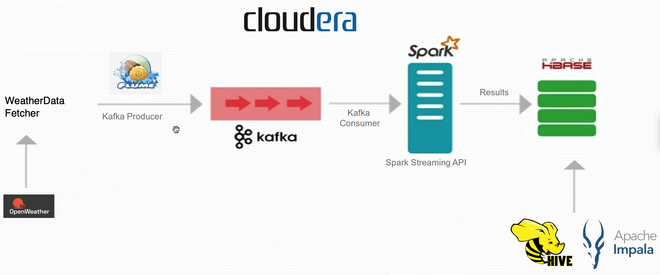
Data flow and system architecture

Slide 7
Challenges
One main challenge was Cloudera VM, a very limited and old system
Initially, we wanted to use Apache Phoenix and Grafana for the nice dashboard to demo weather data but Cloudera VM has a very old browser and it was not possible to update it to make work Grafana, so we gave up Phoenix and Grafana, and used Hive and Impala to show weather dataDislike

Slide 8
Part 1
- Integration with OpenWeatherApp API - Flume - Apache Kafka

Slide 9
Steps that we did to achieve part 1 goals:-
First we installed kafka and use it with the current CDH zookeeper.
Created weather-data topic
Created small project in Java, to fetch weather data from OpenWeatherApp every 3 minutes.
Create conf file for Flume
Run flume and Java app
Now weather data will be fetched every 3 minutes and published to kafka topic using Flume.

Slide 10
Part 2
- Apache Spark Streaming - HBase

Slide 11
Steps that we did to achieve part 2 goals:-
Created maven project for using apache streaming and read real time data from kafka and store it into HBase
In hbase shell we created table (create 'weather_data', 'data’)
Build and run maven project

Slide 12
Part 3
- Hive - Impala

Slide 13
Steps that we did to achieve part 3 goals:
In hive shell we create external table on base of hbase table
In impala shell we can make sql query to see weather data which is update every 3 seconds.

Slide 14
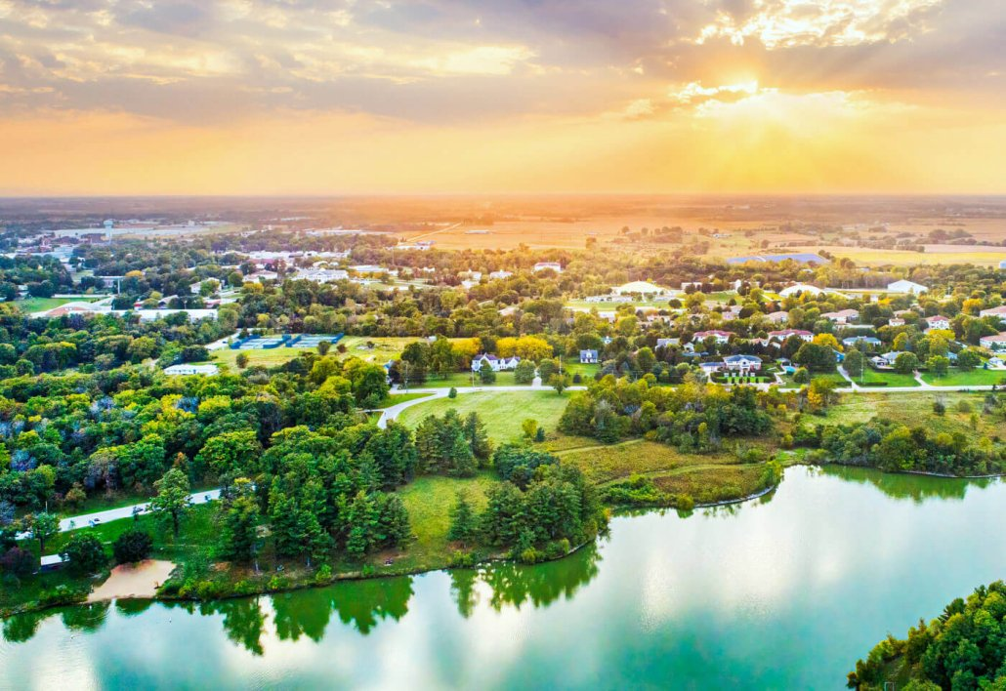
Thank you !

